Slide 1
Weekly Meeting 1
To do:
What is a Robot?
What is difference between Serial and Parallel robotic manipulator?
What are Forward and Inverse Kinematics of a robot?
Derive relationship of Forward and Inverse Kinematics of a 2 D.O.F. serial robot?
What are the main components of a serial robot?
What is the difference between revolute and translational joints?
What is an end effector of a robot?
What is DOF?

Slide 2
What is a Robot?
“A robot is an autonomous machine capable of sensing its environment, carrying out computations to make decisions, and performing actions in the real world.”
A robot is a mechanical or virtual device that is designed to perform tasks autonomously or semi-autonomously. It can be programmed to execute specific actions, interact with its environment, and make decisions based on its sensors and programming.
Robots can come in various forms, ranging from industrial robotic arms used in manufacturing to humanoid robots and autonomous vehicles. They can be controlled by pre-programmed instructions, remote control, or through artificial intelligence algorithms.

Slide 3
What are the main components of a serial robot?
The main components of a serial robot, also known as a serial manipulator or robot arm, typically include:
Base: The base provides stability and serves as the foundation of the robot. It is the fixed or stationary part of the robot that houses the actuators, control systems, and power supply.
Joints: Joints are the movable connections that allow the robot's links to articulate and change their relative positions. The type of joints used depends on the desired range of motion and application requirements. Common joint types include revolute (rotational), prismatic (linear), and combinations of these.
Links: Links are rigid structural elements that connect the joints of the robot. They determine the overall shape, reach, and workspace of the robot. Links can vary in length, shape, and material, depending on the specific robot design.
End Effector: The end effector is the tool or device attached to the last link of the robot. It interacts with the environment and performs specific tasks such as gripping, welding, or sensing. The end effector can be customized based on the intended application, and it often includes mechanisms like grippers, cameras, or specialized tools.
Actuators: Actuators provide the necessary force and motion to drive the robot's joints. They can be electric motors, hydraulic or pneumatic cylinders, or other types of actuators depending on the robot's size, precision, and power requirements.
Sensors: Sensors play a crucial role in robotic systems. They provide feedback and information about the robot's environment, position, forces, and other variables. Common sensors used in serial robots include encoders for joint position feedback, force/torque sensors, proximity sensors, and vision systems.
Control System: The control system includes hardware and software components responsible for controlling the motion, operation, and behavior of the robot. It processes sensor data, generates control signals for the actuators, and implements control algorithms to achieve desired motions or perform tasks.

Slide 4
What is difference between Serial and Parallel robotic manipulator? The main difference between serial and parallel robotic manipulators lies in their structural design and the way they achieve motion.
Serial Manipulator: A serial manipulator, also known as a serial robot, is a type of robotic manipulator where the links or segments of the robot are connected in a linear chain, one after the other. This means that each joint of the robot is actuated independently, and the motion is transmitted serially from the base to the end effector. Serial manipulators are commonly used in industrial robotic arms. Examples include the popular 6-axis robotic arms found in manufacturing applications. Advantages of serial manipulators:
Precise control over individual joints.
More flexibility in terms of workspace and reach.
Easier to program for a wide range of tasks.
Generally simpler kinematics and control algorithms.
Parallel Manipulator: A parallel manipulator, as the name suggests, involves multiple kinematic chains or limbs that are connected in parallel. This means that the end effector is supported and moved by multiple actuators and linkages simultaneously. The actuators and linkages work together in a coordinated manner to control the motion of the end effector. Parallel manipulators are often used in applications where high precision, stiffness, or specific force distribution is required. Advantages of parallel manipulators:
High rigidity and stiffness due to multiple actuators and linkages.
Enhanced precision and accuracy in certain applications.
Better force distribution capabilities.
Faster response and dynamic performance.

Slide 5
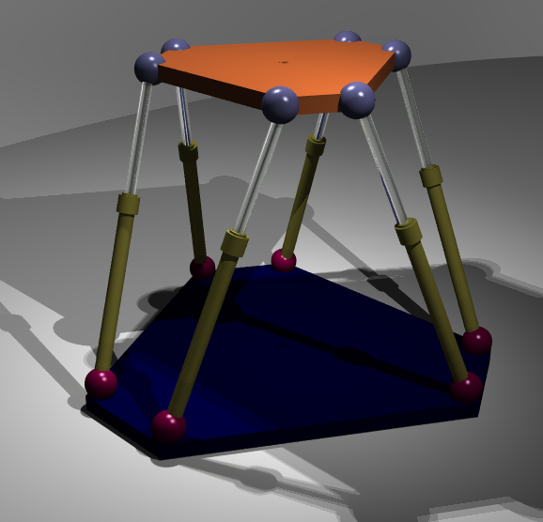
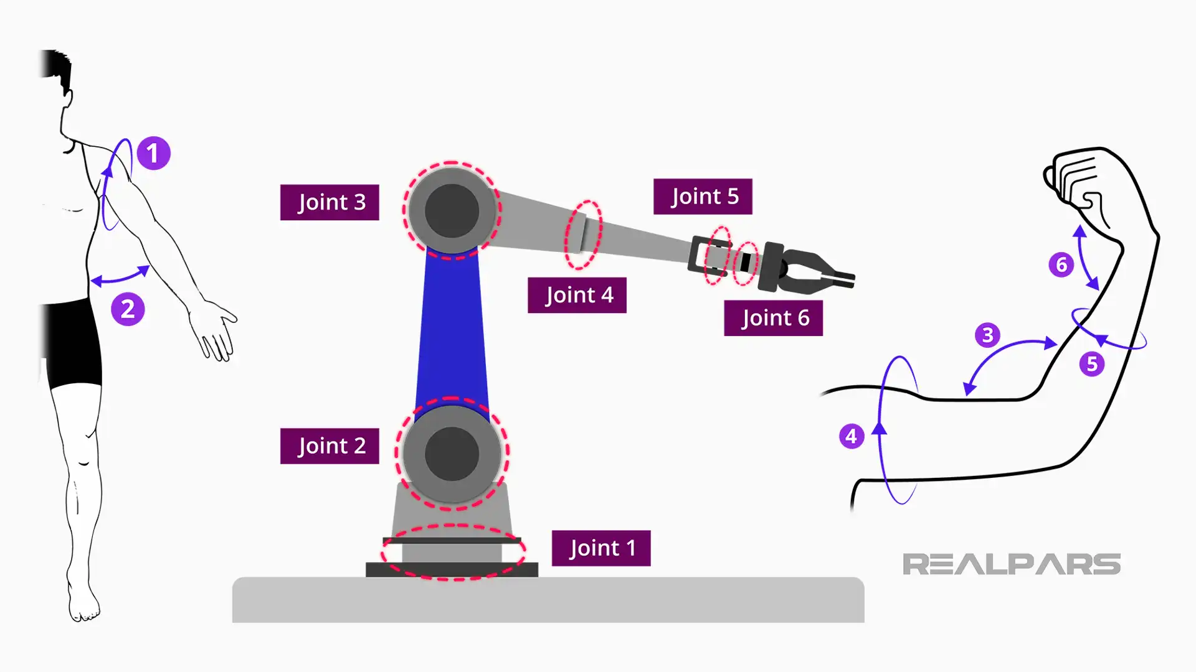
Pictures
Serial Manipulator
Parallel Manipulator

Slide 6
In what category does a quadruped lie?
A quadruped typically falls under the category of a parallel manipulator. This is because a quadruped robot consists of multiple limbs (four legs in this case) that are connected in parallel. Each leg of the robot operates independently and contributes to the overall motion and control of the robot.
In a quadruped robot, the legs work in a coordinated manner to provide stability, locomotion, and manipulation capabilities. The parallel structure of the quadruped allows for better force distribution, stability, and the ability to perform dynamic movements.
It's worth noting that while a quadruped robot can be considered a parallel manipulator in terms of its structure, the specific implementation and design choices can vary. Some quadruped robots may have additional serial manipulators or mechanisms incorporated for specialized tasks or functionalities.

Slide 7
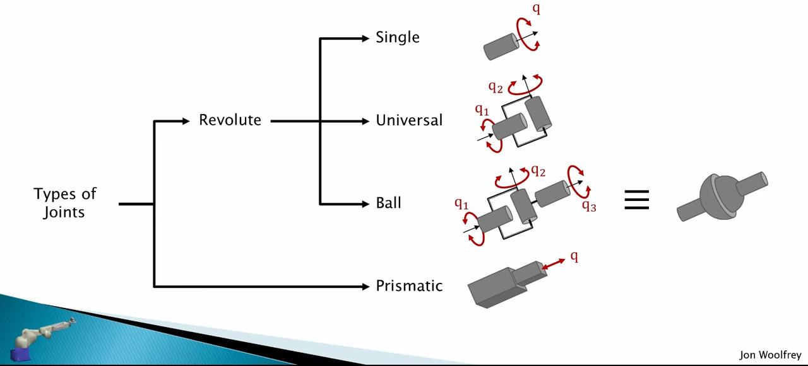
Types of Joints
Revolute Joint: This is a rotary joint that allows rotational motion around a single axis. It is often referred to as a "hinge" or "rotational" joint. Examples include the joints in a human arm or the wheels of a car.
Prismatic Joint: This joint allows linear motion along a single axis. It is also known as a "slider" or "translational" joint. An example is a sliding drawer or a telescopic antenna.

Slide 8
What is DOF?
DOF stands for "Degrees of Freedom" in the context of robotics and mechanical systems. It refers to the number of independent variables or parameters that can be controlled or varied to describe the motion or configuration of a system.
In robotics, DOF represents the number of independent joint variables or axes that a robot possesses. Each degree of freedom corresponds to a specific joint that can move independently. For example, a robot arm with three revolute joints and two prismatic joints would have a total of five degrees of freedom. The DOF determines the range and complexity of motions that a robot can achieve.

Slide 9
Forward & Reverse Kinematics
Forward kinematics is a method used in robotics to determine the end effector's pose (position and orientation) based on the joint angles and link lengths of a robot. It involves computing the transformation from the robot's base frame to the end effector frame.
Inverse kinematics is a technique used in robotics to determine the joint angles of a robot's manipulator in order to achieve a desired end effector position and orientation. It involves solving the mathematical equations that relate the robot's joint variables to its end effector pose.
Calculations for the forward and inverse kinematics of a 2DOF planar manipulator is done on notebook using the coordinate transformation method.

Slide 10
Week 2
To do: Maze Search
Blind Search
BFS: Breadth First Search
DFS: Depth First Search
Uniform Cost
Informed Search
Greedy Search
A* Algorithm
Q-learning

